Slide 1
Hand Sign Language Recognition
Abinaya U (19PD02)
Dhikshitha A (19PD09)

Slide 2
Introduction
Sign Language is a form of communication used primarily by people hard of hearing or deaf.
Hand sign language recognition system takes an input sign as an image from deaf and dumb person gives output to the normal person in form of text or voice.
The letters indicated by hand signs can further be concatenated to form a string.
Notes:
Sign Language is a form of communication used primarily by people hard of hearing or deaf and is usually not known to normal people, so it becomes a challenge for a normal person to communicate with a hearing impaired person.
The sign language is a very important way of communication for deaf-dumb people. .
It is basically a non-verbal language which is usually used to deaf and dumb people to communicate more effectively with each other or normal people.
Sign language contains special rules and grammars for expressing effectively.

Slide 3
Motivation
Sign language is learned by deaf and dumb, usually it is not known to normal people, so it becomes a challenge to establish a communication between normal person and hearing impaired person.
So, it strikes a bridge between hearing impaired person and normal person to make communication easier.

Slide 4
Problem statement
To understand the exact context of the symbolic expressions of deaf and dumb person and provide an efficient and accurate way to convert the sign language into text.
ASL (American Sign Language) is used to detect and predict the hand signs of the deaf and dumb person.
ASL is a complete, natural language that has the same linguistic properties as spoken languages, with grammar that differs from English.
ASL is expressed by movements of the hands and face.
Notes:
It is the primary language of many North Americans who are deaf and hard of hearing and is used by some hearing people as well.

Slide 5
Dataset
Image Dataset:
Collection of images labelled as 36 classes, of which
26 are for the ASL alphabets A-Z
10 classes for the numbers 0-9.

Slide 6
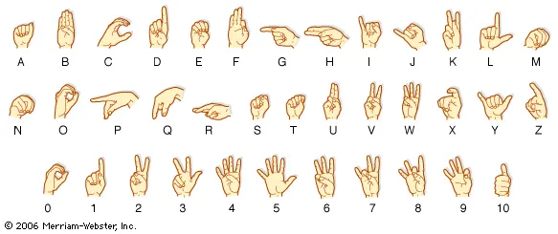

Slide 7
Proposed Solution
Convolution Neural Networks (CNN):
Convolutional Neural Network (ConvNet/CNN) is a Deep Learning algorithm that can take in an input image, assign importance (learnable weights and biases) to various aspects/objects in the image, and be able to differentiate one from the other.
The architecture performs a better fitting to the image dataset due to the reduction in the number of parameters involved and the reusability of weights.
Notes:
A CNN is a kind of network architecture for deep learning algorithms and is specifically used for image recognition and tasks that involve the processing of pixel data.

Slide 8
WorkFlow of project
Data Acquisition
Image Pre-processing
Data Augmentation
Model Building (CNN)
Model Evaluation

Slide 9
Data Preprocessing
There are several techniques used to preprocess the data:
Colour image conversion to grayscale and reduction the size of an image
Getting more contrast in an image using histogram equalization
Image binarization to remove background and enhance an object image
Detection edge of an image to reduce the amount of data and get only important features

Slide 10
Data Augmentation
With spatial transformation techniques, pixels are moved around the image in set ways to create the augmented image like flipping, rotation, translation, cropping.
With colour transformation techniques, the spatial aspect of the image is normally preserved while the values of the pixels are edited like brightness, contrast etc …
Notes:
During the training, it was also added another data augmentation process consisting of performing some transformations, such as some rotations, changes in light intensity, and rescaling. These two data augmentation process were chosen to help improve the generalization capability of the model.

Slide 11
CNN Architecture - Model Building and Training
ConvNet architectures are basically made of 3 elements:-
Convolution Layers
Pooling Layers
Fully Connected Layers

Slide 12
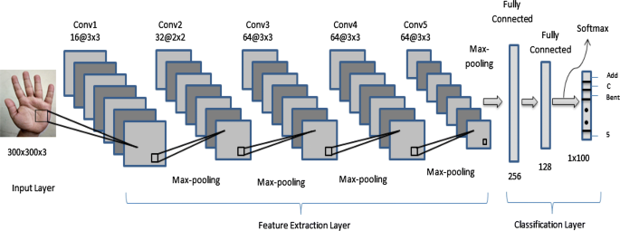
Notes:
https://towardsdatascience.com/sign-language-recognition-using-deep-learning-6549268c60bd

Slide 13
Model Evaluation and Real time prediction:
Evaluate the trained model using Accuracy, Precision, Recall, F1 score, confusion matrix.
At first, CNN model will be tested with the existing image dataset and then the CNN model s used to predict the real time hand sign images.
In the real-time prediction step, hand positions will be captured using a python library and will sent to the model for prediction. Now the trained model finds the best match for the given sign and output the predicted label.
Notes:
In this case, the confusion matrix provides comprehensive intuition into the performance of problem classifier.
Model evaluation includes accuracy, precision, and speed. From this, the best-performing model was identified, allowing the necessary recommendations to be given.

Slide 14
THANK YOU

